Slide 1
IoT Interoperability with W3C Web of Things
Michael Lagally Jan 2022

Slide 2
W3C Web of Things Use Cases and Concepts

Slide 3
Web of Things: Horizontal and Vertical Use Cases
Agriculture
Smart Cities
Building Technologies
Manufacturing
Retail
Retail
Health
Energy
Transportation
Automotive
Smart Home
Education
Security
Discovery
Multi-Vendor System Integration
Out of the box interoperability
Digital Twins
Cross Protocol Interworking
Multimodal System Integration
Accessibility

Slide 4
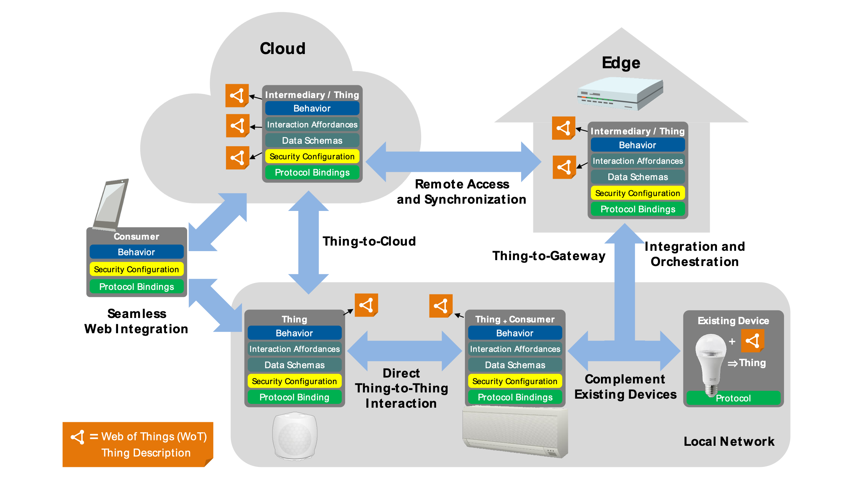
W3C Web of Things – Abstract Architecture

Slide 5
Web Things: A common interaction model across protocols
Properties
Actions
Events
Links
Interaction Model
HTTP(S)
Binding
MQTT
Binding
CoAP
Binding
other
Bindings

Slide 6
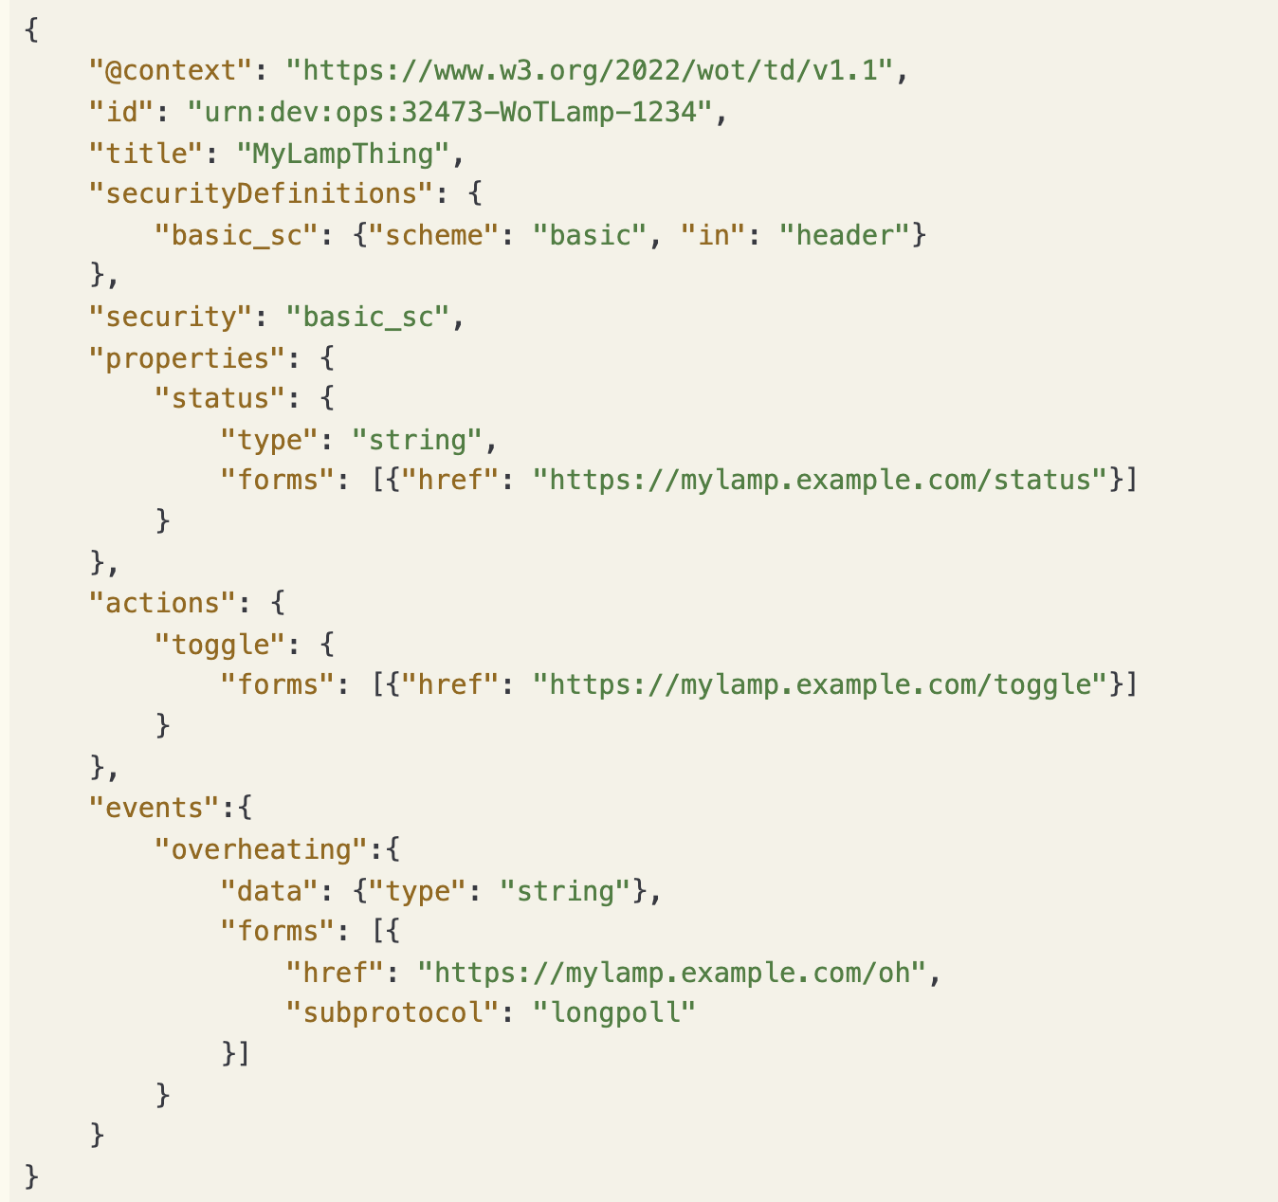
WoT Thing Description – A common description language
WoT Thing Descriptions define a protocol agnostic information model which can be augmented with semantic annotations to add context knowledge.
The interaction affordances of that model can be bound to different protocols, and a single WoT Thing Description can contain bindings for several protocols.
Thing Descriptions are typically encoded in a JSON format that also allows JSON-LD (semantic linked data) processing.

Slide 7
What is out of the box interoperability OOTBI?

Slide 8
User Scenarios
As an end user, I want to know whether a device will work with my system before I purchase it to avoid wasting money.
As a developer, I want TDs to be as simple as possible so that I can efficiently develop them.
As a developer, I want to be able to validate that a Thing will be compatible with a Consumer without having to test against every possible consumer.
As a System Integrator, I want to integrate devices from multiple vendors without deep customisation.

Slide 9
Out-of-the-box interoperability
Devices from multiple vendors can be integrated together into various application scenarios without deep level adaptations.
Typically only minor configuration operations are necessary (such as entering a network key, or IP address) to use the device in a certain scenario.
These actions can be done by anyone without specific training.

Slide 10
Why do we need OOTBI?

Slide 11
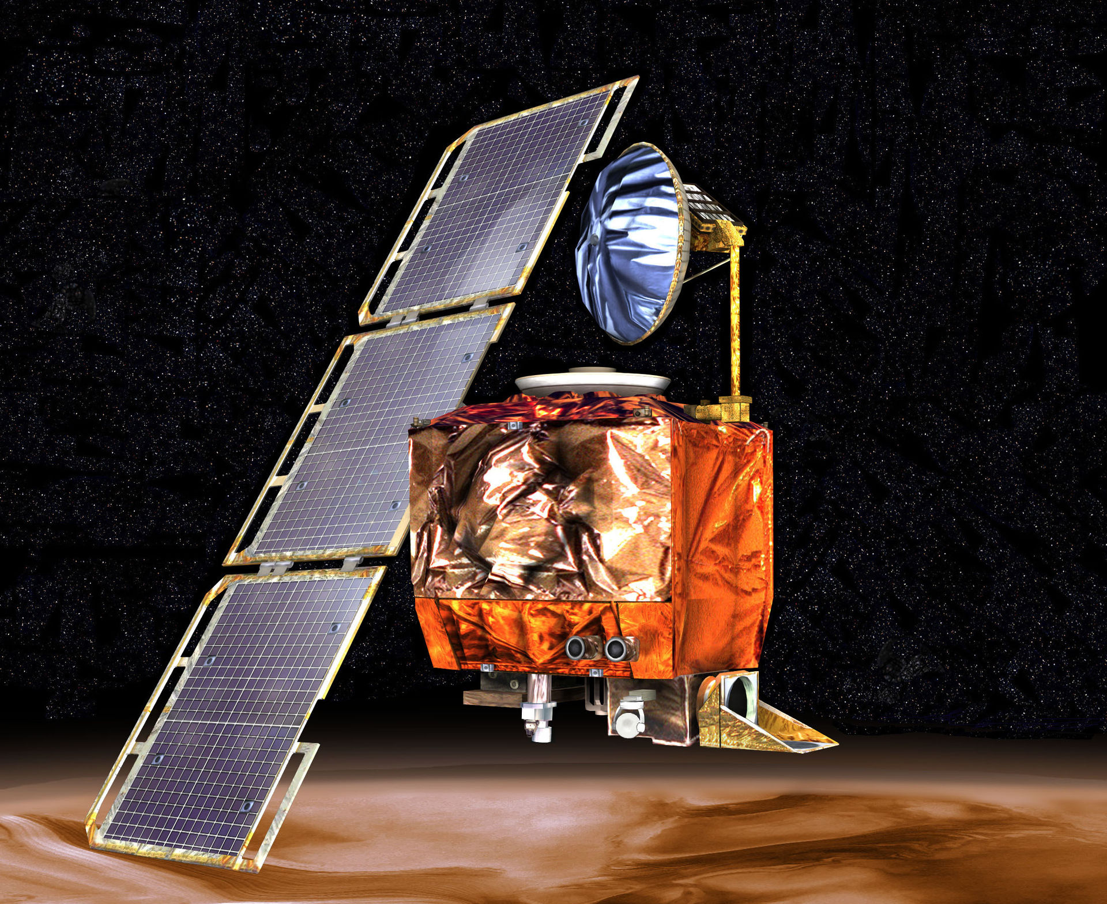
Mars Climate Orbiter (1999)
The primary cause of this discrepancy was that one piece of ground software produced results in a United States customary unit, contrary to its Software Interface Specification (SIS), while a second system, supplied by NASA, expected those results to be in SI units, in accordance with the SIS. Specifically, software that calculated the total impulse produced by thruster firings produced results in pound-force seconds. The trajectory calculation software then used these results – expected to be in newton seconds – to update the predicted position of the spacecraft.
Source: https://en.wikipedia.org/wiki/Mars_Climate_Orbiter
11

Slide 12
How could W3C WoT have helped to prevented that?
There was a clear system description describing the measurement system (SI units).
One company was not using the right metric system
They made implicit assumptions
WoT Thing Descriptions include a unit, which implies that people think about the interpretation of the associated value.
A Profile can enforce using units for measurable values.
12

Slide 13
Example OOTBI Scenario: Telemetry
A worldwide climate monitoring system obtains data from sensors and gateways around the world to indicate the current weather conditions and to be able to predict critical conditions.
The system displays a world map with all sensors, where the user can zoom in to individual regions.
Temperature, humidity and other sensor readings etc. are provided to a common server, which aggregates the data and uses configurable rules to trigger alerts based on sensor data.
This example motivates to consider the following aspects:
All sensors and gateways must use unit schemes that are known and can be interpreted by the consumer.
All sensors and gateways must use an unambiguous time and date format.
All sensors and gateways must provide a human readable name that can be displayed on a map.
All sensors and gateways must provide their location in a format that is known to the consumer.
If a sensor and gateways provides interactions, these must be displayed in a UI in a human readable form.
Sensor readings will be displayed in a UI, the names must be displayed in a UI in a human readable form.

Slide 14
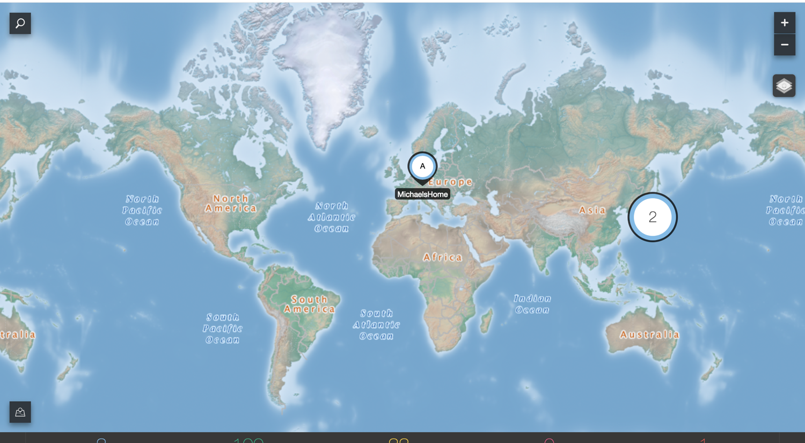
WoT Plugfest Scenario
Fujitsu Beacon Light
Intel Webspeak, RGB Light
Hitachi Node-RED
SmartThings Light
France
Siemens FESTO Plant
Germany
KETI Environment Sensor
Korea
Oracle Datacenter
IOT Cloud Service
Asset Monitoring
USA
Panasonic
Smart Home
Fujitsu Smart Home
Japan

Slide 15
System Integration Challenges
For a system integrator all these four interoperability layers are required to ensure OOTBI:
Technical Interoperability: OOTBI at protocol layer, use of HTTP(s), authentication mechanisms, self descriptive things (discovery)
Syntactic Interoperability: well defined JSON format, validation, max lengths, common field names, guaranteed fields. common error response format, event payload, error codes, unambiguous mapping of HTTP protocol verbs (e.g. PUT vs. POST).
Semantic Interoperability: consistent data model across things, e.g. unambiguous units, date + time representation, fields have the same "meaning", i.e. comon interpretation of values across devices and vendors.
Organisational Interoperability: things have the same behavior, if they are used in the same way. This is independent from the manufacturer, geographical location, and other situation context. Behavior is independent from the network topology or protocol stack.
See also: https://european-iot-pilots.eu/wp-content/uploads/2018/11/D06_02_WP06_H2020_CREATE-IoT_Final.pdf

Slide 16
WoT Profiles
Why, What, How?

Slide 17
WoT Interoperability: Why do we need a WoT Profile?
The WoT Architecture and Thing Description define a generic powerful description mechanism and a machine-readable format.
The format is very flexible and open and puts very few normative requirements on devices that implement it.
Without additional rules, WoT's flexibility allows implementers to make many choices that do not provide guarantees of common behavior between implementations.

Slide 18
What is a WoT Profile?
The Web of Things (WoT) Profile specification is being proposed to address these challenges and to enable out-of-the-box interoperability.
Things conforming to the same profile should work together without custom adaptation other than the usual security onboarding and network configuration.
The WoT Profile specification defines a set of common constraints on the information model, and rules which compliant Thing Descriptions must adopt to achieve interoperability.
These rules are prescriptive, to ensure that compliant implementations satisfy the semantic guarantees implied by them.
This set of rules is called a Profile.

Slide 19
How to define a Profile?
Properties
Actions
Events
Links
Interaction Model
HTTP(S)
Binding
MQTT
Binding
CoAP
Binding
other
Bindings

Slide 20
How to define a Profile?
Properties
Actions
Events
Links
WoT Profile
Interaction Model
+
Clarifications, Constraints, Recommended Practice, Protocol Binding, Interaction Semantics
HTTP(S)
Binding
MQTT
Binding
CoAP
Binding
other
Bindings

Slide 21
How to define a Profile
A set of rules which compliant Web Things must adopt to achieve interoperability.
These rules are prescriptive, to ensure that compliant implementations satisfy the semantic guarantees implied by them.
Common constraints on the information model, e.g. nesting depth, mandatory metadata fields.
Clarifications on data types (e.g. date and time) and unit systems.
Unambiguous HTTP(s) protocol binding, common error behavior.
Common well-defined behavior of interactions for properties, synchronous and asynchronous actions, events.
Well-defined payload formats for error responses, action status and events.

Slide 22
The WoT HTTP + JSON profile
HTTP(s) + JSON Protocol Binding
Metadata requirements and type clarifications
Readable and writable properties
Synchronous and asynchronous actions
Scalable event model
Validation with JSON schema
Guidelines and recommended practice

Slide 23
WoT HTTP + JSON Profile Common Datamodel + Operation Semantics
Properties
read
write
Observable Properties
observe
Actions
invoke
query
cancel
Pull Events
subscribe
unsubscribe
Push Events
subscribe
unsubscribe
Common Datamodel + Operation Semantics
Common Datamodel + Operation Semantics
Common Datamodel + Operation Semantics
Common Payload format (JSON)
Common Payload format (JSON)
Common Event Object format (JSON)
HTTP(S)
Binding
HTTP(S)
Binding
HTTP(S)
Binding
SSE
LongPoll
Web Hook
…

Slide 24
Summary and Conclusion
All WoT specification drafts are available on their respective github repositories.
The architecture task force in the WoT working group is working towards completion of the HTTP + JSON profile specification.
Future profiles are envisioned to be defined based on use cases and requirements for other application domains and protocols.
If you would like to contribute to WoT use cases or participate in the profile work, please contact the author.

Slide 25
References
W3C Web of Things: https://www.w3.org/WoT
WoT Use Cases and Requirements: http://w3c/wot-usecases
WoT Architecture: https://github.com/w3c/wot-architecture
WoT Thing Description: https://github.com/w3c/wot-thing-description
WoT Profile: https://github.com/w3c/wot-profile

